Slide 1
Nagios Infrastructure Monitoring

Slide 2
Nagios Core
Nagios Core, is a free and open source computer-software application that monitors systems, networks and infrastructure.
Nagios offers monitoring and alerting services for servers, switches, applications and services.
It alerts users when things go wrong and alerts them a second time when the problem has been resolved.

Slide 3
Originally released in 2002, 17 years ago.
I am using version 4.4.2 released in august
Originally designed to run under linux, but runs well on Unix variants

Slide 4
Cons of Nagios (In my opinion)
Takes along to set up if you aren’t familiar
Not a lot of easily helpful documentation on current software release
Time Consuming
A lot of configuration files that are challenging to setup and edit in vim, can easily make mistakes this way if something misspelled
Cant manage the network or computer, just monitors it.

Slide 5
Pros of Nagios
Free

Slide 6
Graphical Overview of Common Nagios Configurations

Slide 7
2014 Mac book pro
Virtual box VM
Ubuntu Desktop
Nagios 4.4.2

Slide 8
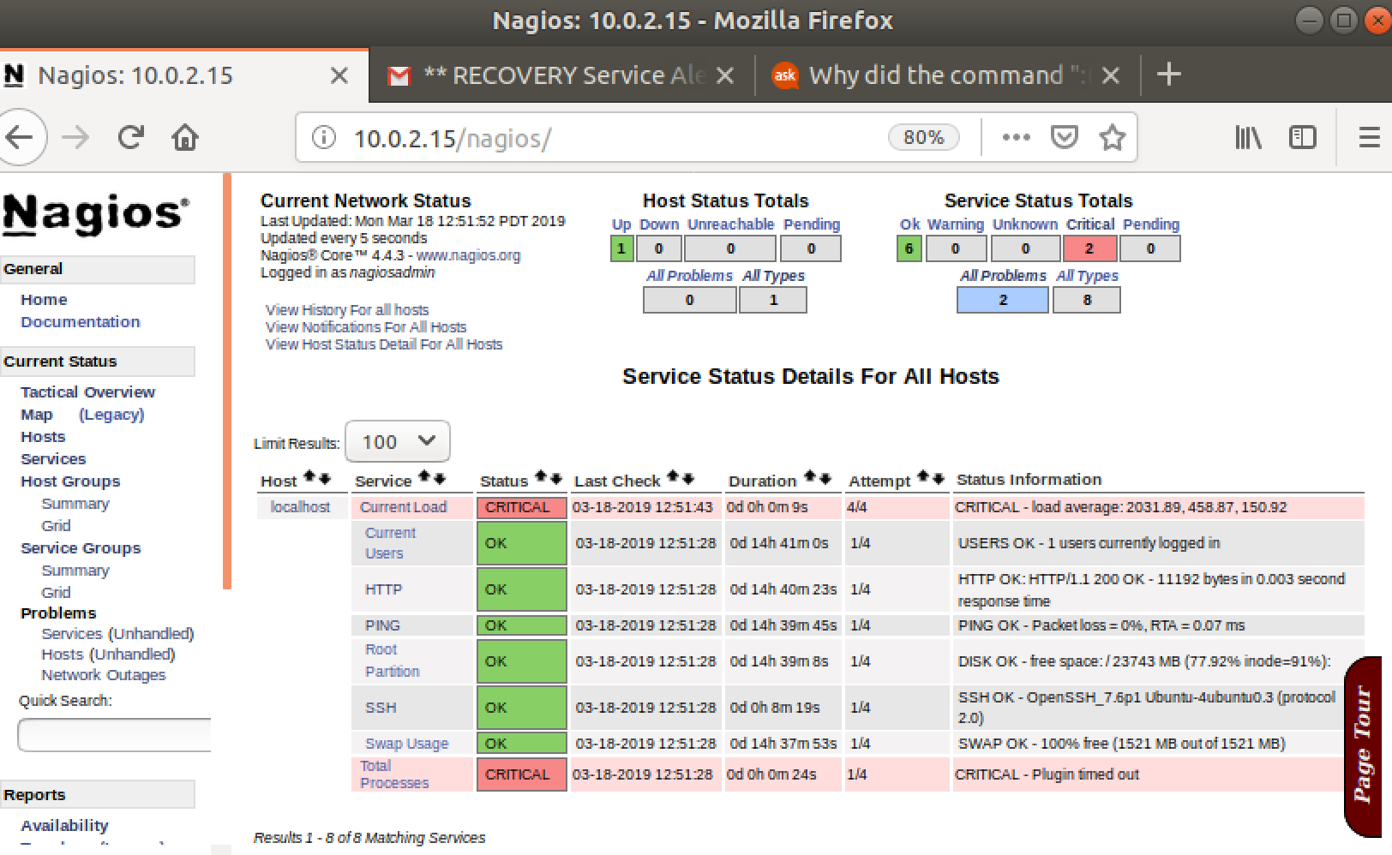
Notifications and Alerts
Set up email notifications when system has an alert.
Very quick
Capable to notify system administrators of issues

Slide 9
Control of Nagios Tool (Pretty Simple)
$ Service nagios start
To start the tool
$ Service nagios status
To check the status of the tool
$Service nagios stop
To stop the tool

Slide 10
3 Services that I am monitoring with Nagios on the Virtual Machine
Current Load
SSH
Total processes

Slide 11
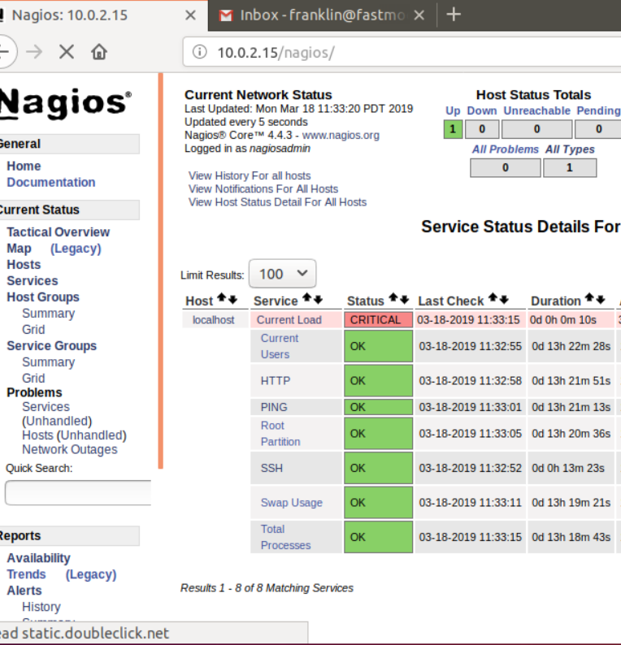
Current Load Attack
I am using the stress tool.
The stress tool is a tool that imposes load and stress test on systems.
I have put the stress command in a shell script which I activate on the VM.
This triggers notification on Nagios and sends email

Slide 12
SSH Disabling
In order for me to disable this system, I simply use the command $ service SSH stop.
I put the ssh commands in to shell scripts that I use to activate the alerts on my VM.
SSH is disabled upon machine startup (weirdly)

Slide 13
Total Processes Attack
Fork Bomb
A fork bomb is a denial of service attack where a process repeats itself with the goal of depleting available system resources, which slows down the system or crashes the system because of limited resources.
Fork bombs take down the system by consuming CPU time in the process of forking, and by saturating the operating systems process table.
A basic fork bomb is one that launches new copies of itself.

Slide 14
Things I learned
Apache Server
Nagios Tool
Nagios Troubleshooting
Admin setup (notifications, email)
Contacts.cfg File
Configuration ( check intervals of service, status intervals) cgi.conf file
Give virtual machine a lot of memory, so it runs faster

